Slide 1



Slide 2
NETFLIX MOVIES AND
TV SHOWS

Slide 3



Netflix
Presenters Names
SUVIN SHAH
ARSHIA NOOR
DHRUVIL SHAH

Slide 4

Netflix
4
Subtitle
INTRODUCTION
97% for you
16+
2022
The Netflix movies and TV shows dataset is a large collection of information about the content available on the Netflix platform. The dataset includes a list of all the movies and TV shows available on Netflix, as well as information such as cast, directors, ratings, release year, duration, and other pertinent details.
The dataset contains information about over 8000 Netflix movies and TV shows, including cast, directors, ratings, release year, duration, and other relevant information. Because the data is organized in a tabular format, it is simple to analyze using various data analysis and machine learning techniques.
Overall, the Netflix movies and TV shows dataset is a valuable resource for anyone interested in understanding the content available on the Netflix platform, as well as those seeking insights into the platform's preferences and habits.
Skip

Slide 5

NETFLIX
4
Subtitle
PROBLEM
DEFINITION
97% for you
16+
2022
Netflix is a popular media and video streaming platform that offers a large selection of movies and television shows. The platform has over 8000 movies and TV shows available for streaming as of mid-2021. This includes a wide variety of content from a variety of genres and countries. Netflix is a global platform with over 200 million subscribers, making it one of the world's most popular streaming platforms. Our plan is to use the provided dataset on Netflix shows to obtain the proper rating of each show so that we can create a better way to present them to viewers so that they can choose their shows based on the rating of the show.
Play
+

Slide 6
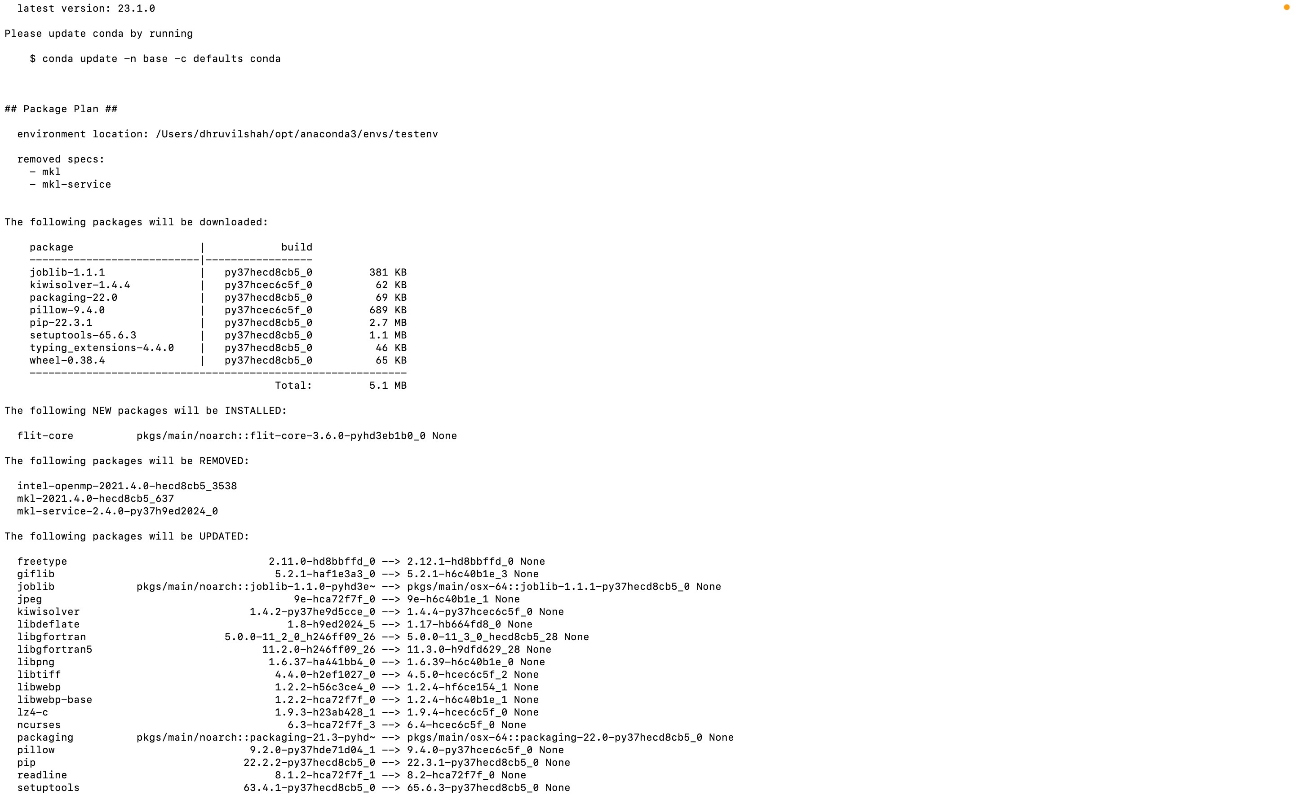
NEtflix
4
Virtual Environment

Slide 7
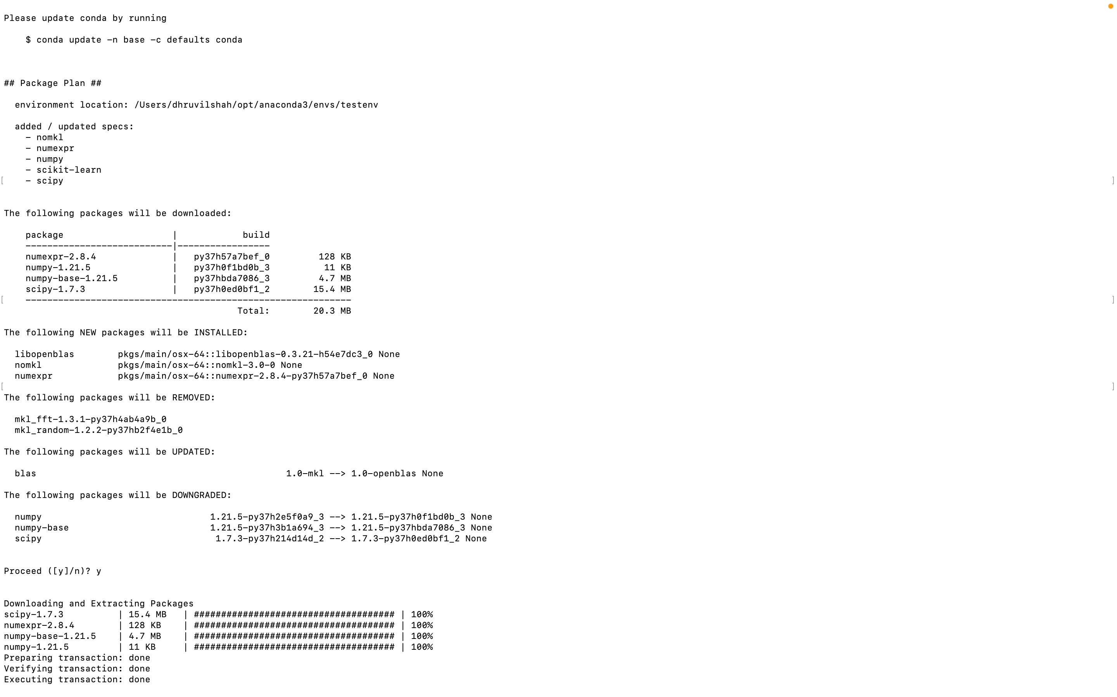

Slide 8
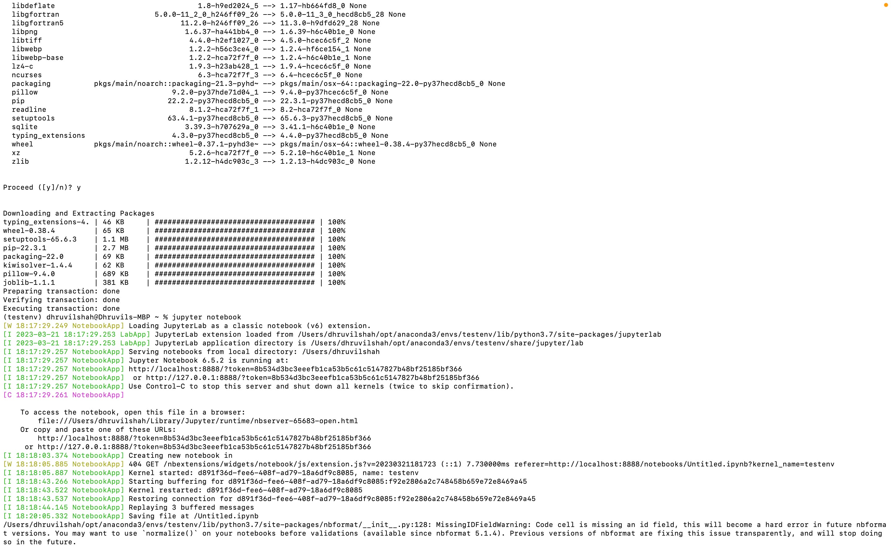

Slide 9
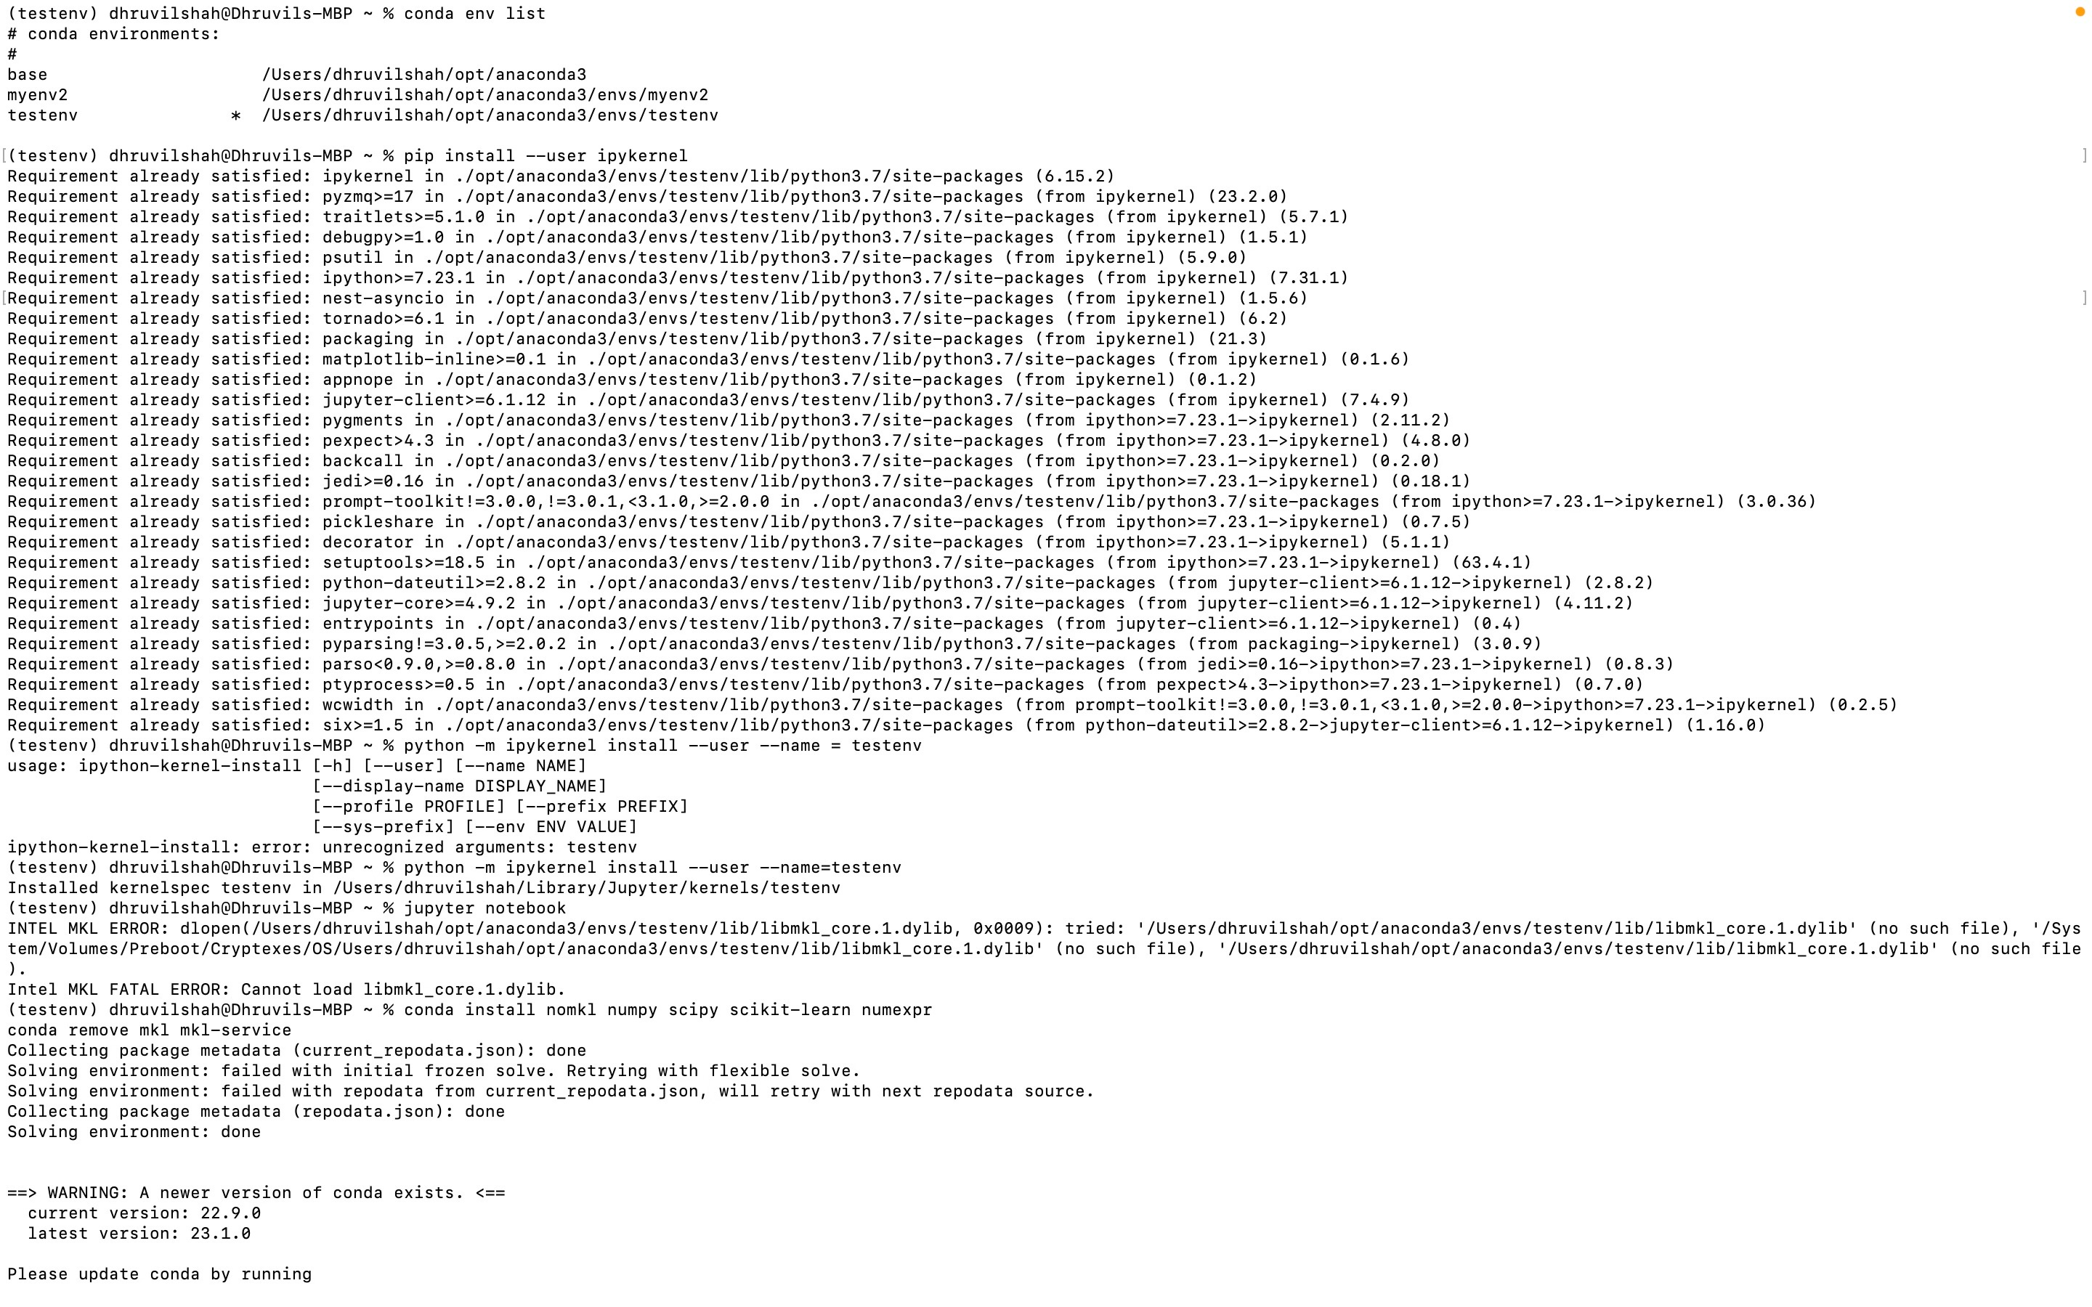

Slide 10
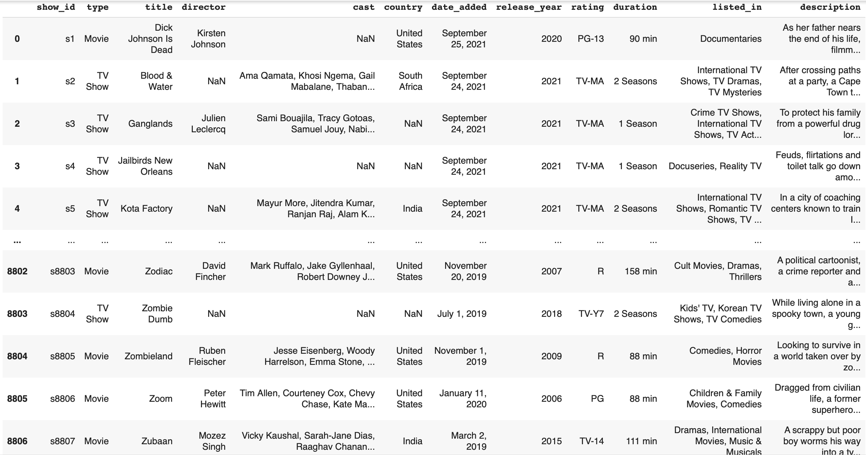
NEtflix
4
Dataset Used

Slide 11
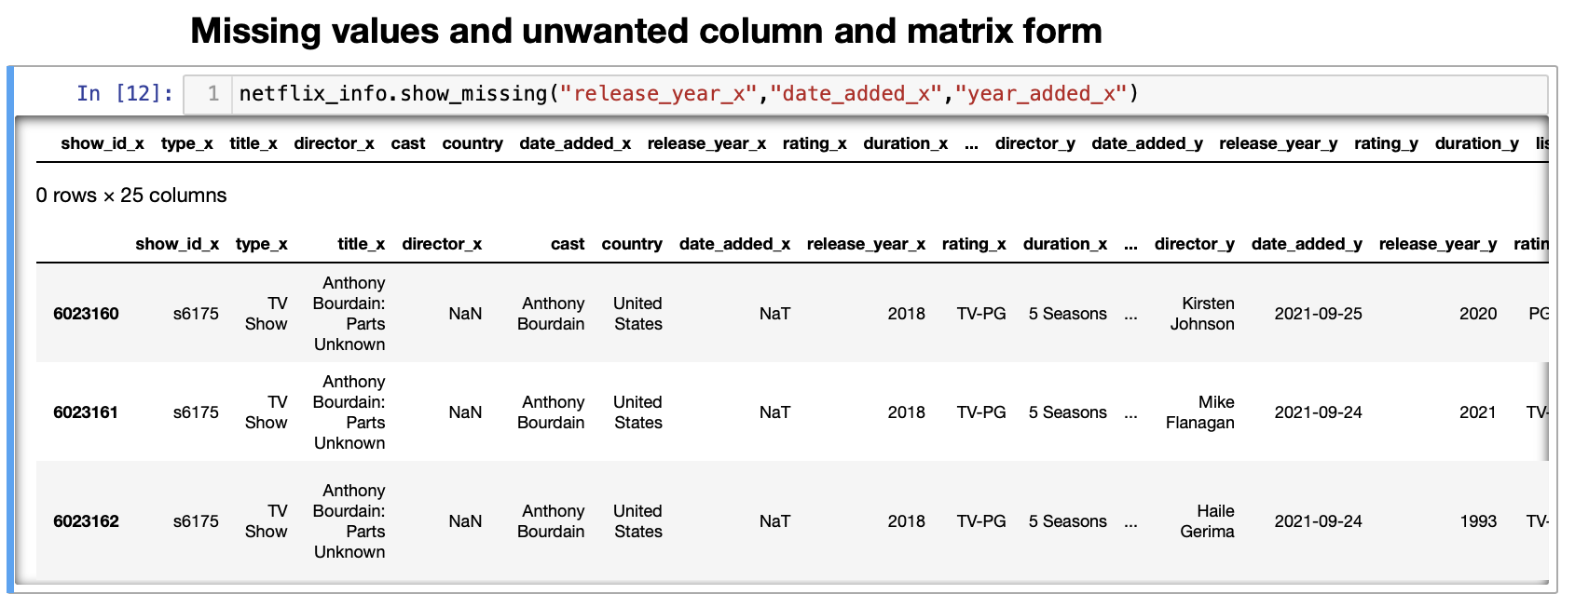
NEtflix
4
Missing Values

Slide 12
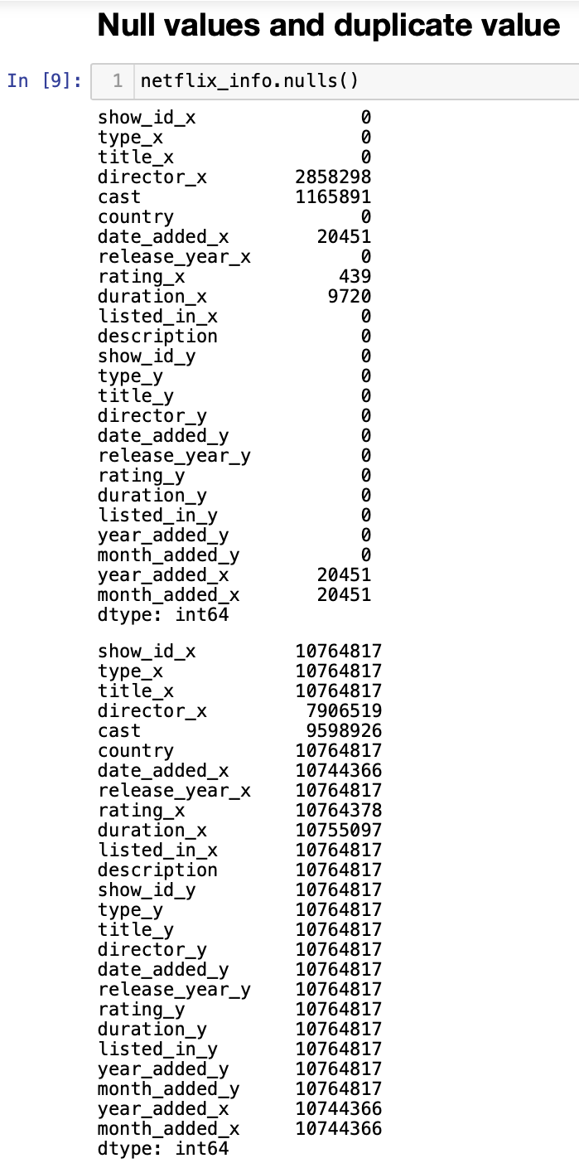
NEtflix
4
Detecting
Null
And
Duplicate Values

Slide 13
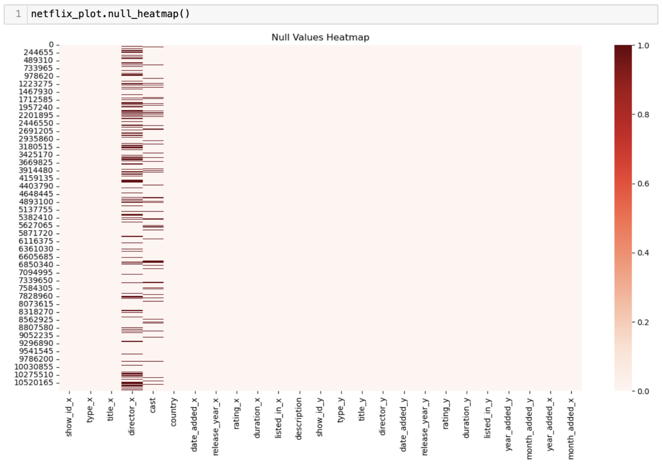
NEtflix
4
Null Values Heat Map

Slide 14
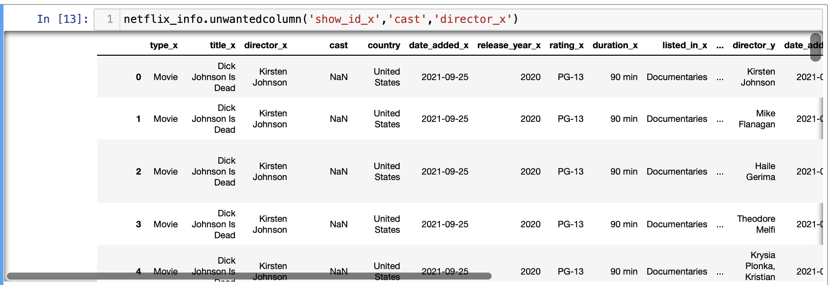
Netflix
4
Dropping Unwanted Columns

Slide 15
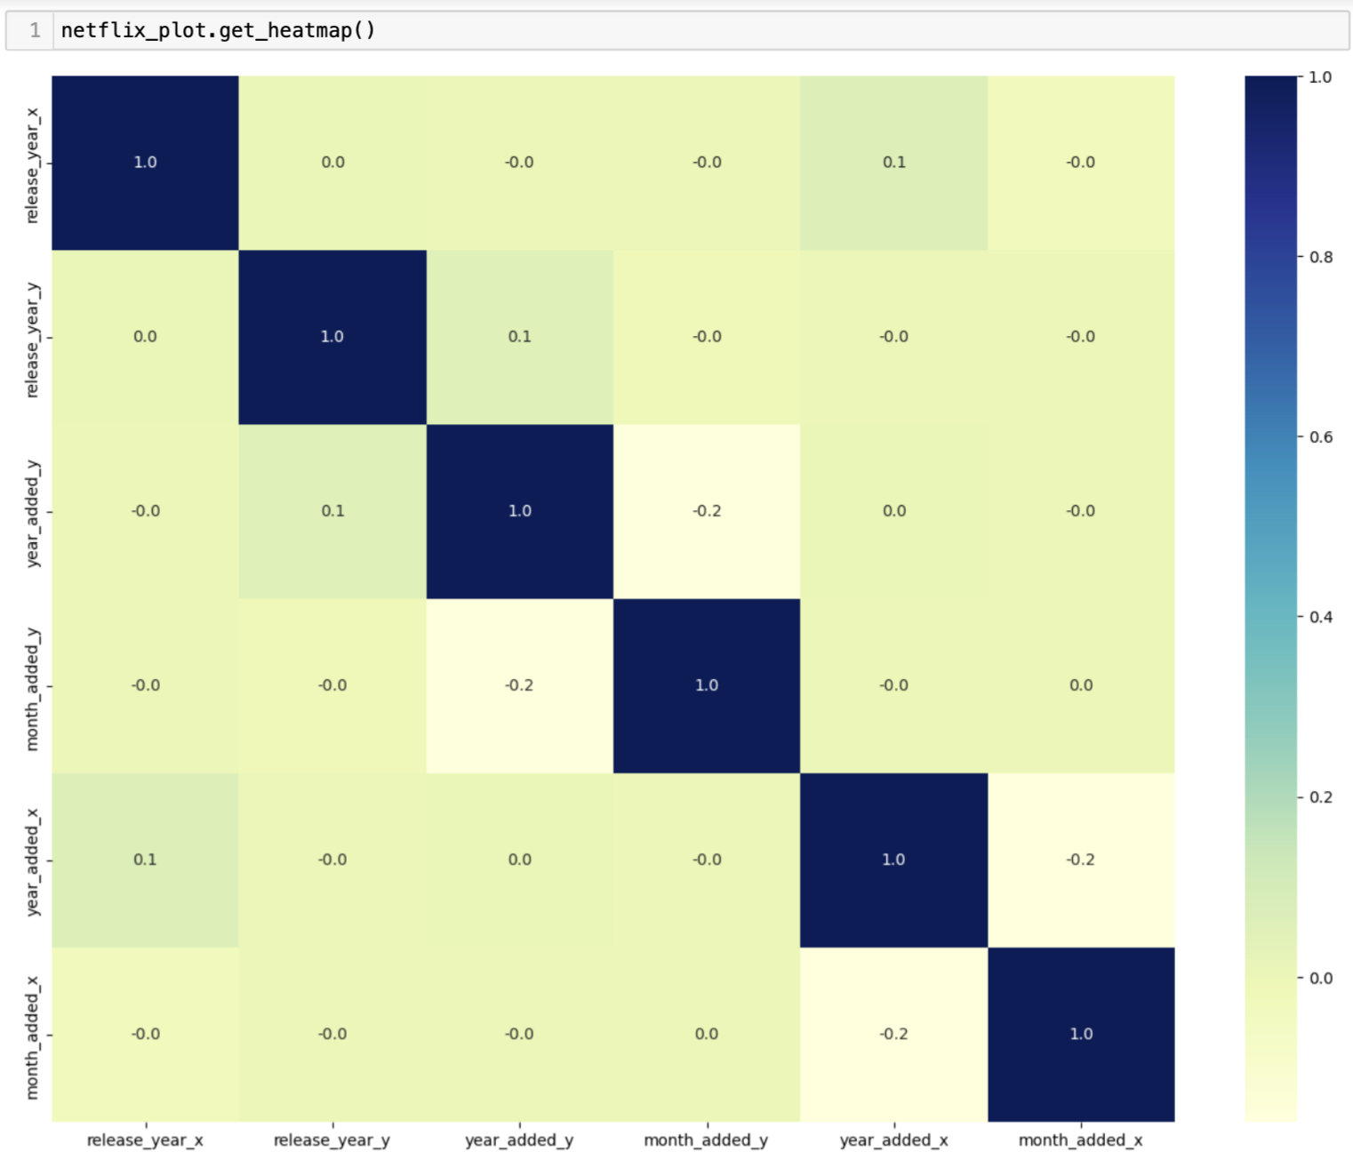
Netflix
4
Heat Map

Slide 16
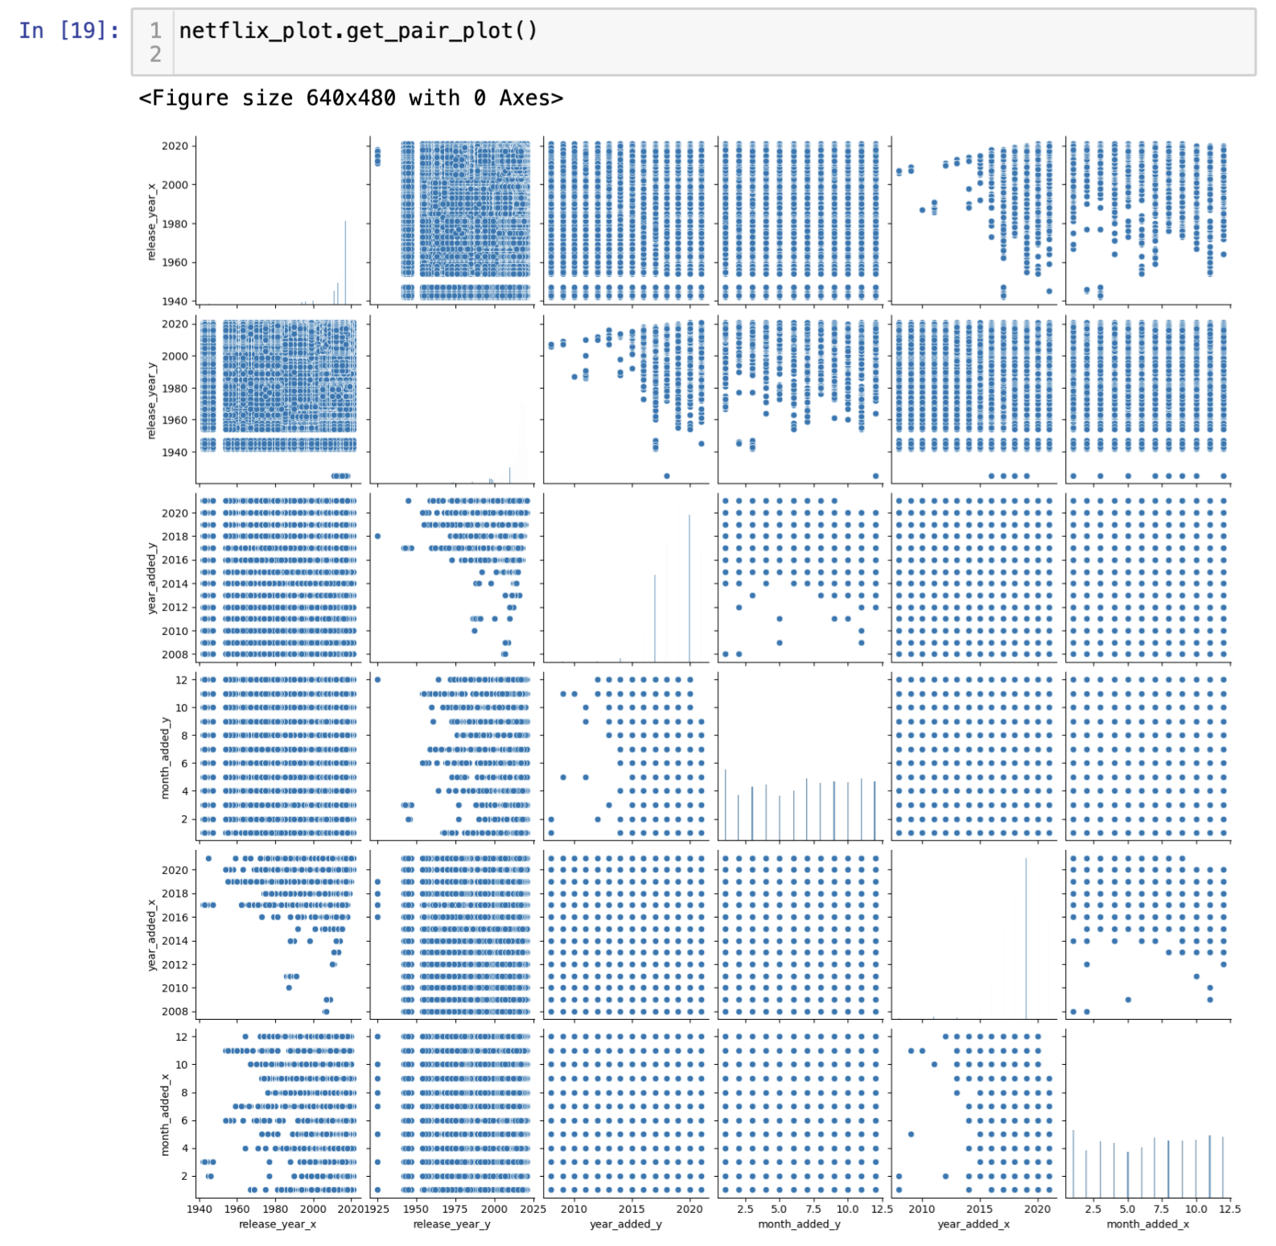
Netflix
Pair Plots
4

Slide 17
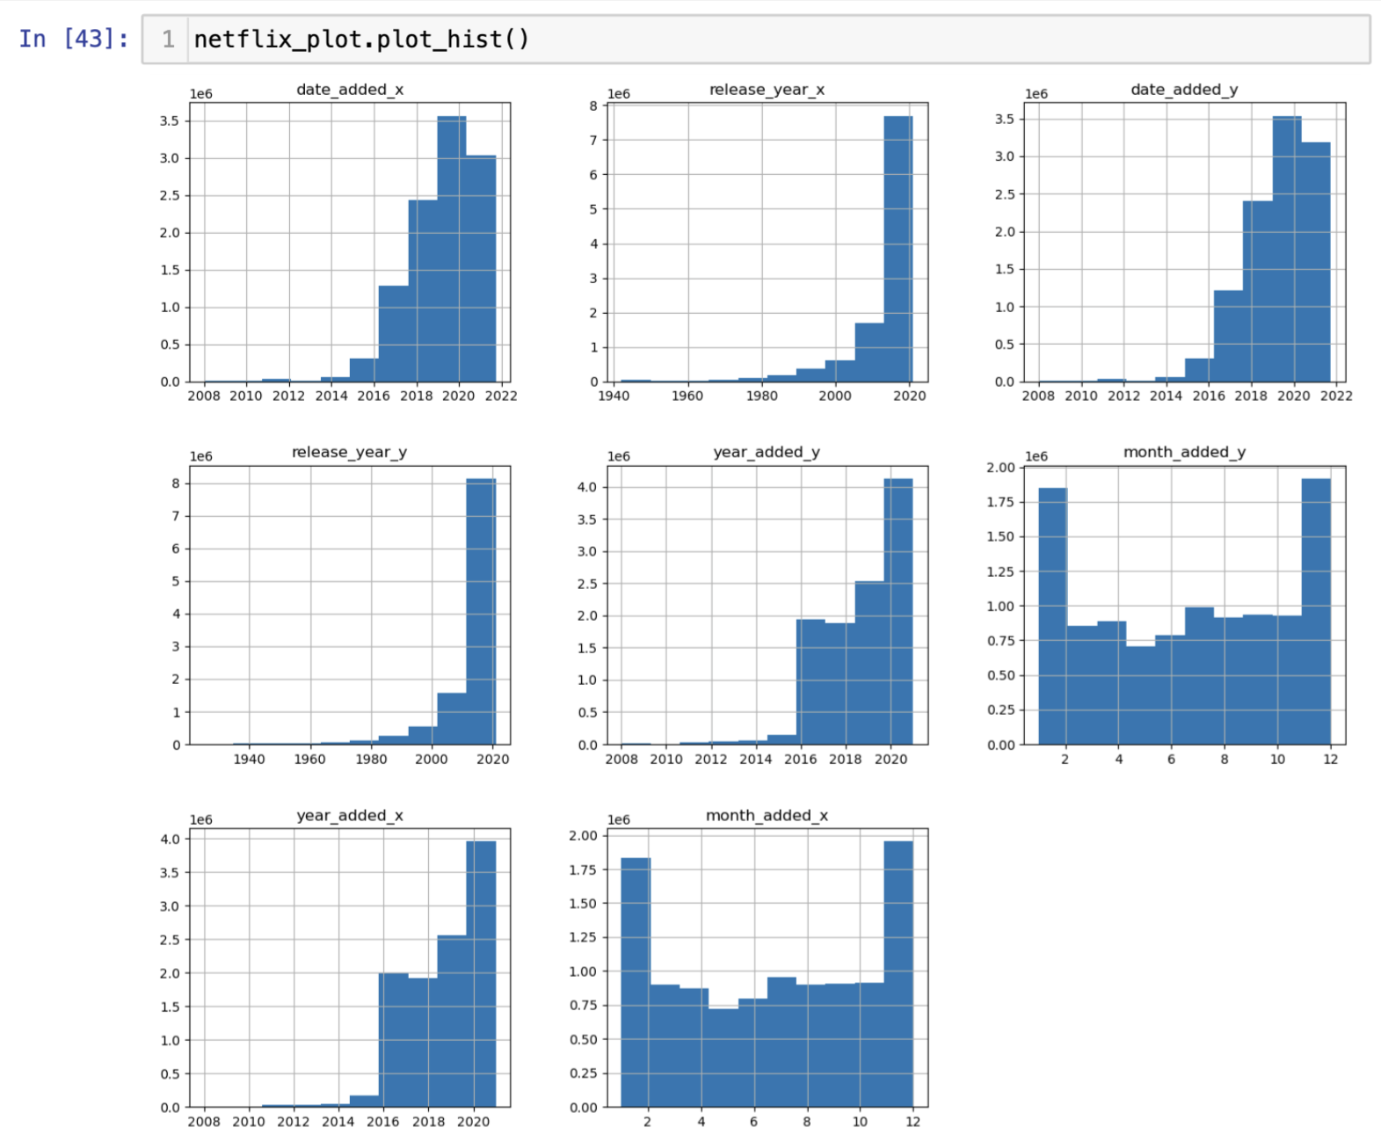
Netflix
Histogram
4

Slide 18
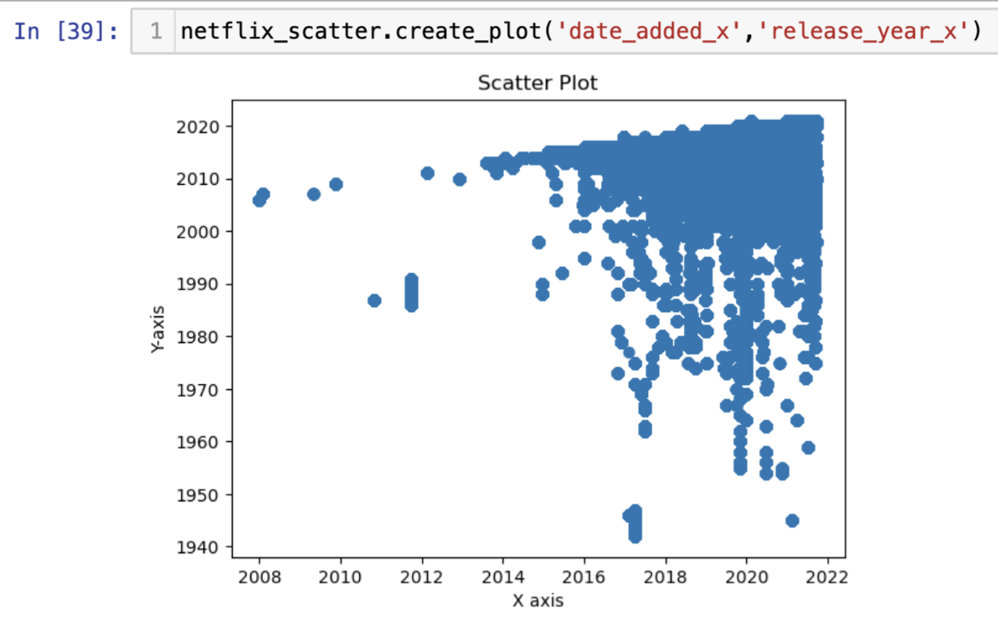
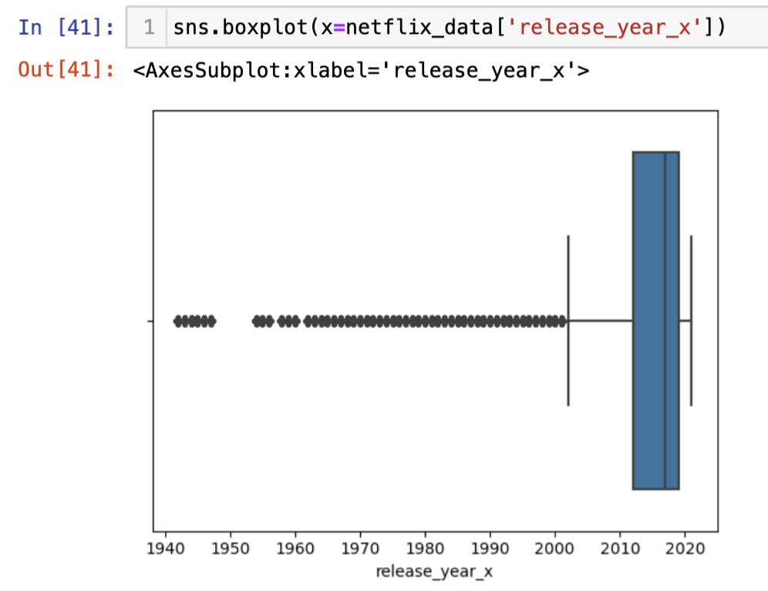
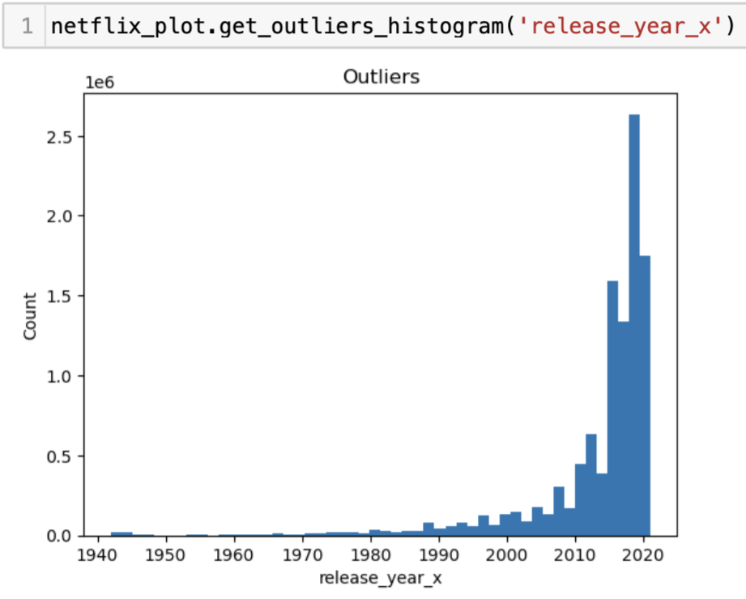
Netflix
4
Visualization of Dataset
Scatter Plot
Box Plot
Histogram

Slide 19
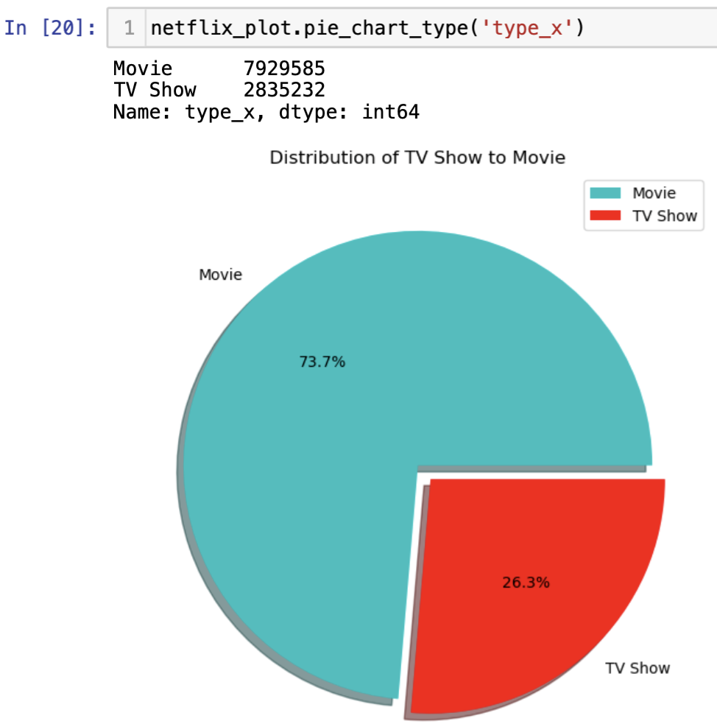

Netflix
Pie Chart
4

Slide 20
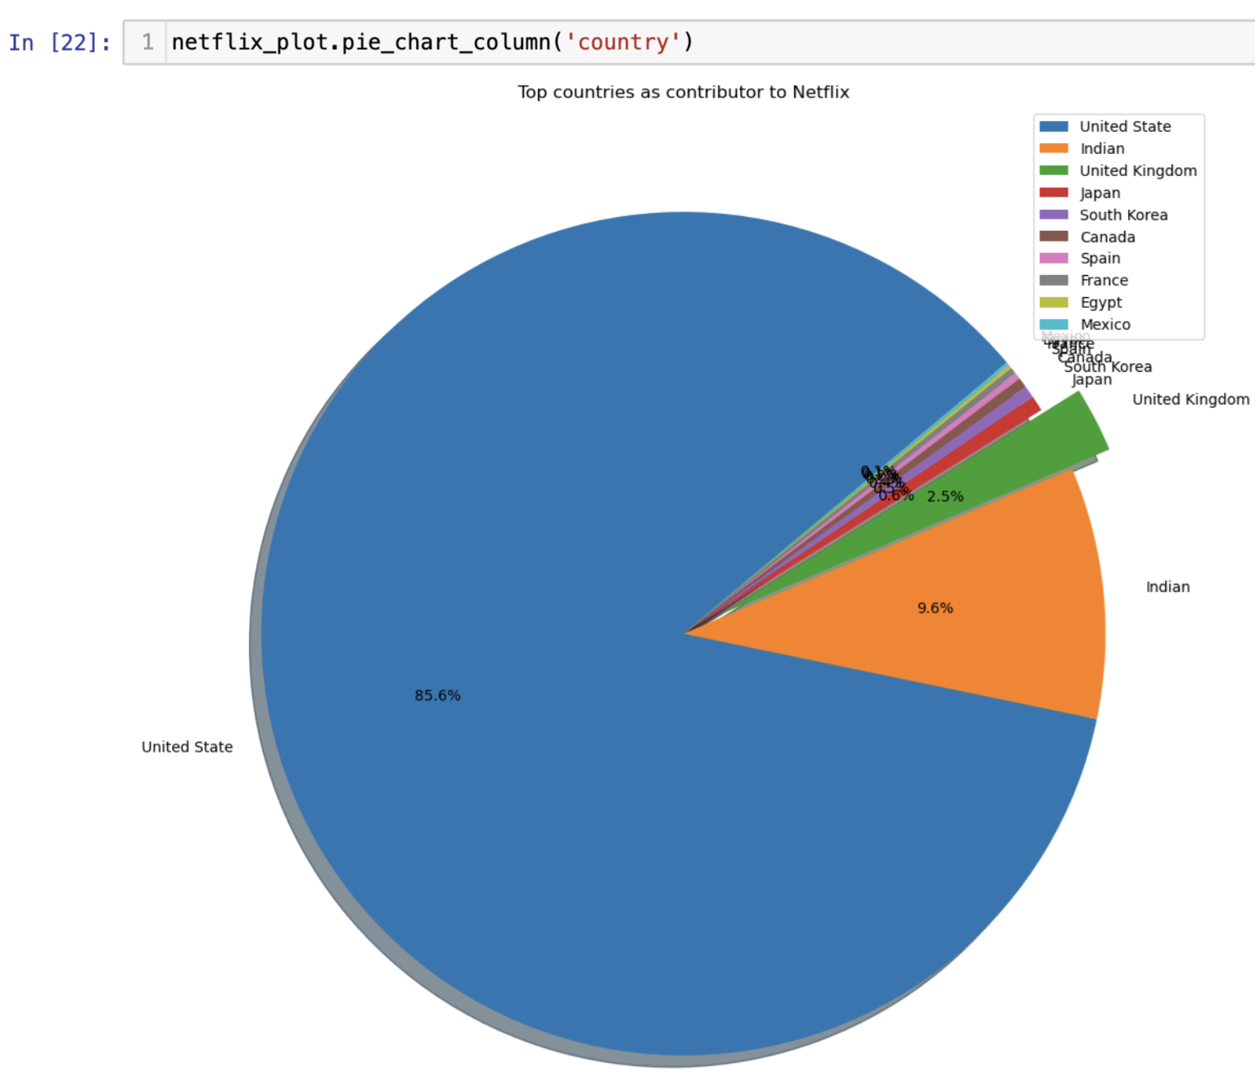
Pie Chart
Netflix
4

Slide 21
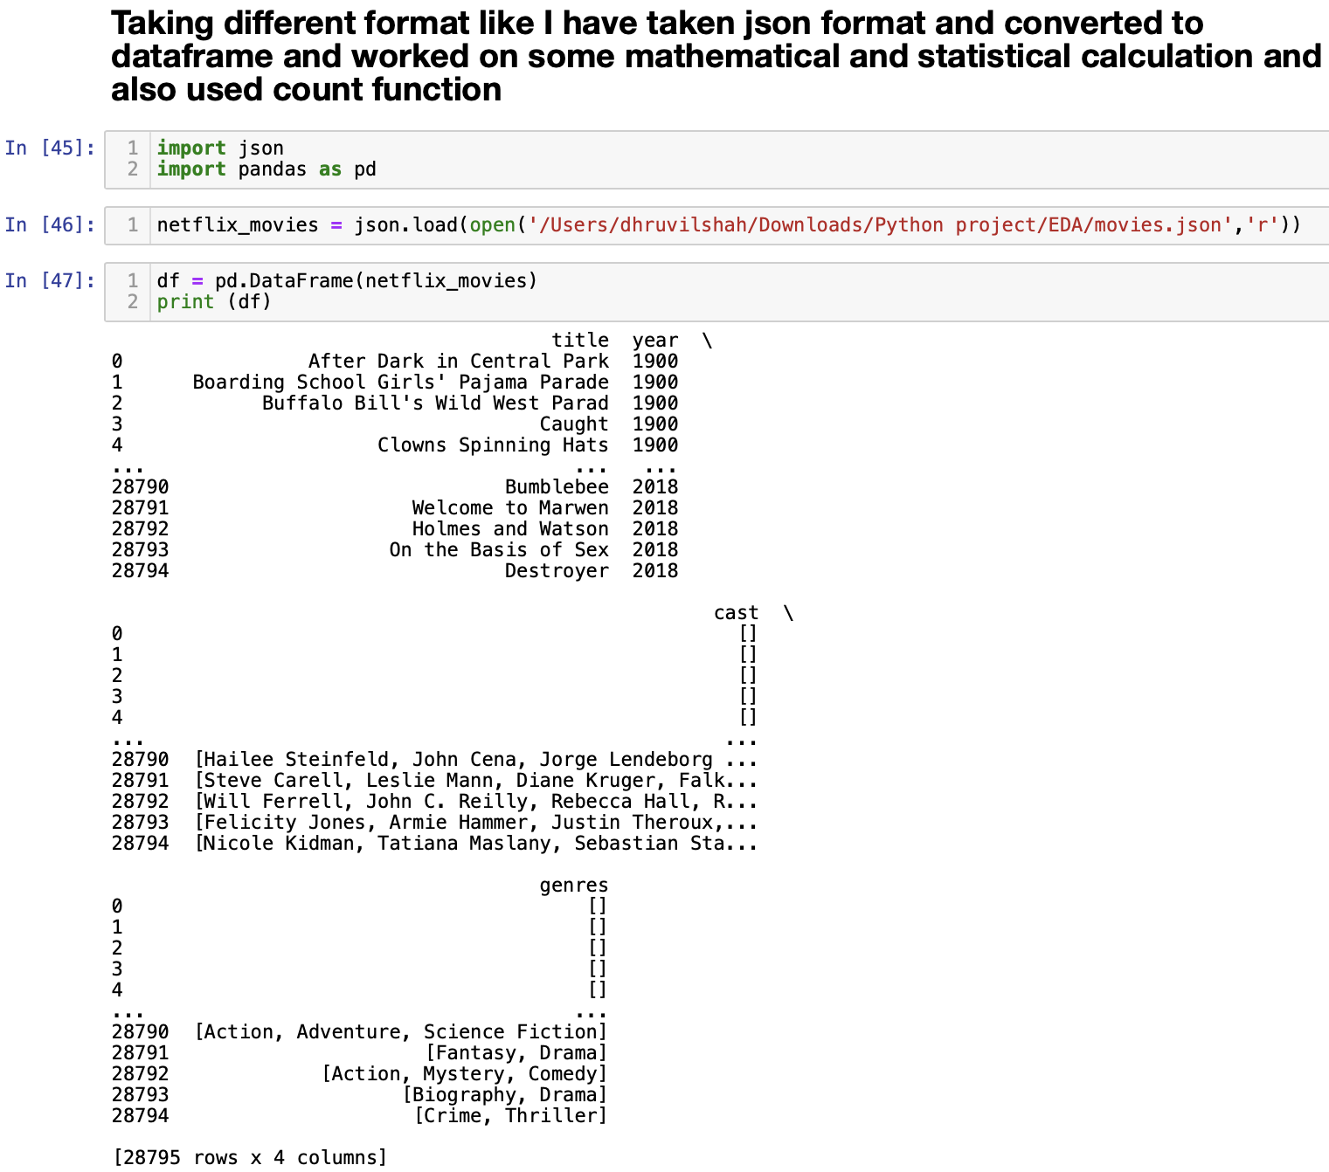
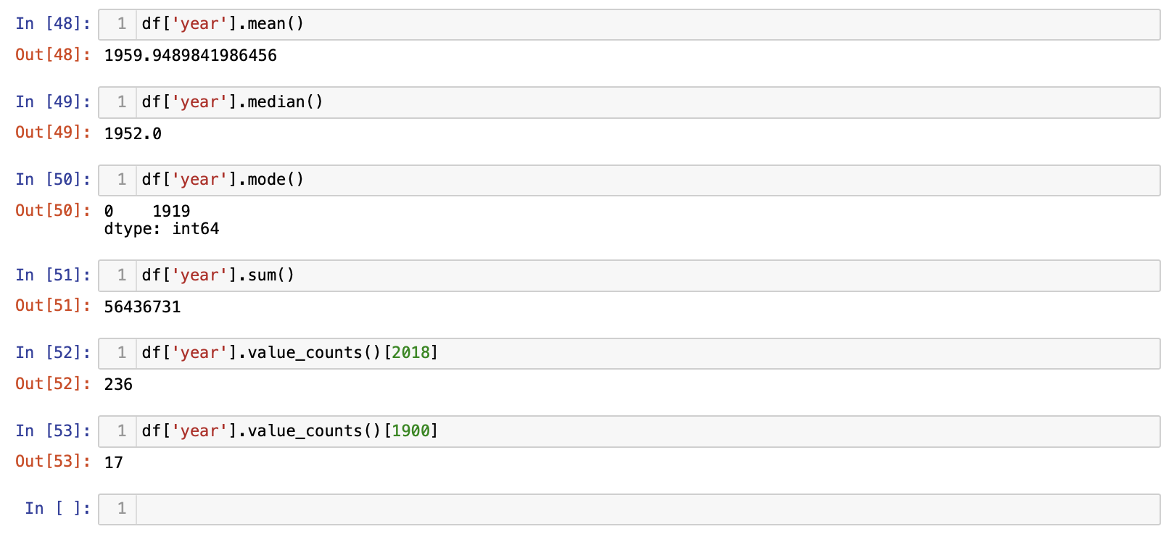
Netflix
4
Use of Json Format

Slide 22

Subtitle
RESULTS
97% for you
16+
2022
Our objective is to perform EDA on the chosen dataset, but there were numerous difficulties because we used Netflix's movies and TV series as our dataset. We had to remove a few columns and convert the category data to numerical in order to get the right outcome.
Play

Slide 23

Netflix
4
Subtitle
CONCLUSION
97% for you
16+
2022
While Netflix is a well-known media company and online video streaming service with a wide selection of movies and television shows, working with the enormous dataset has been particularly difficult. Over 8000 movies and TV shows will be streamable on the website by the middle of 2021. This includes a vast variety of material from many genres and countries. One of the most well-known streaming services is Netflix, which has more than 200 million subscribers worldwide. Our strategy is to use the provided dataset on Netflix shows to obtain the accurate rating of each show in order to provide a better method of presenting Netflix shows to viewers so that they may choose their programs based on the rating of the show.
Play
See More

Slide 24
REFRENCES
Subtitle | Group 9
Next
The dataset was also used in a research paper titled "A Deep Learning Approach for Predicting the Popularity of Netflix Content" by Sai Kiran Kolla, Praneeth Alla, and Chetan Puri: https://ieeexplore.ieee.org/document/9523115
The dataset was also used in a blog post titled "Exploring Netflix Data with Python" by Selva Prabhakaran: https://www.machinelearningplus.com/python/exploratory-data-analysis-python/
The dataset was also used in a Medium article titled "Netflix Data Analysis and Visualization" by Sebastian Szwarc: https://medium.com/swlh/netflix-data-analysis-and-visualization-70f1bdcda67b
These references provide different perspectives on the use of the dataset, including data analysis, machine learning, and data visualization.

Slide 25
thanks

